Slide 1
Bangla Speech Emotion Recognition With Intensity Level Using Feature Transformation And Deep Learning
Presented by:
Md. Masum Billah
Roll: 1707098
Md. Likhon Sarker
Roll: 1607069
Supervised by:
Dr. Md. Aminul Haque Akhand
Professor
Department of Computer Science and Engineering
Khulna University of Engineering & Technology, Khulna

Slide 2
Outlines
Purpose
Background
Specific Aims
Data Collection and Description
Methodology
Experimental Results and Analysis
Conclusions
References

Slide 3
Purpose
For Bangla language, there is still the lacking of a useful linguistics resource for emotion recognition.
Our purpose is to make a Bangla language dataset that can be used to recognize emotional state from speech signals.

Slide 4
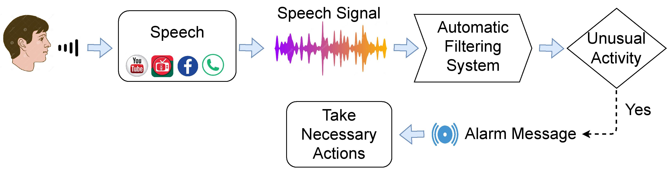
Purpose
To build a model that helps the supportive system to take necessary actions when any unusual activity occurs.
Figure 1: System that provides support by filtering unusual activities in speech signals.

Slide 5
Background
Speech Emotion Recognition (SER) task involves identifying and categorizing emotional elements of speech.
The SER process involves two stages which are extracting features from the speech signal and classifying emotions.
Several deep learning models based on neural networks have been explored for SER, including Convolutional Neural Networks (CNN), Long Short Term Memory (LSTM), and Recurrent Neural Networks (RNN).

Slide 6
Specific Aim
Create the emotional speech corpus for the Bangla language in a realistic environment.
Classify emotions and their intensity level from Bangla speech .

Slide 7
Data Collection and Description
We have collected 900 speeches from 34 actors from various Bangla resources.
Dataset is named BESCK (Bangla Emotional Speech Corpus KUET)
Data are separated according to five emotions such as Neutral, Happy, Sad, Angry, Disgust.
Each emotion can have two intensity level except neutral.
Intensity:
Normal
Very
Ex: Angry, Very angry

Slide 8
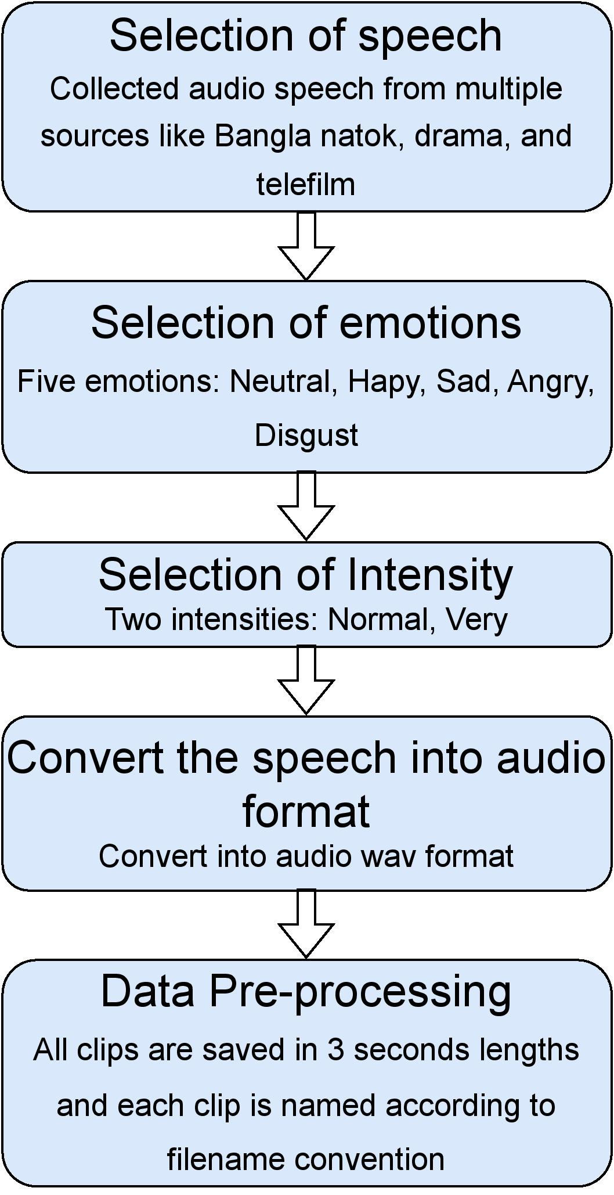
Workflow Diagram of the BESCK Dataset Preparation

Slide 9
Summarization of Our BESCK Dataset
Descriptions | Values
Source | Bangla Natok, Drama, Telefilm
Used Language | Standard Bangla
Corpus type | Realistic
File type | Audio only
File format of audio clips type | WAV
Sampling rate | 48 kHz
Number of actors | 34
Size of the dataset | 497 MB
Number of emotions | Five
Number of intensity level | Two
Emotion states | Neutral, Happy, Sad, Angry, Disgust
Intensity states | Normal, Strong
Number of sentences | Random
Total number of audio clips | 900
Audio duration per clip | 3 seconds
Total duration of the corpus | 2700 seconds
Utilized software | VideoProc Converter, Any Video Converter

Slide 10
Description of the Filename Convention
Identifier | Meaning
Emotion | 1 = Neutral, 2 = Happy, 3 = Sad, 4 = Angry, 5 = Disgust
Intensity | 1 = Normal, 2 = Strong
Gender | 0 = Female, 1 = Male
Speech number | 001 = 1st Speech, … , 050 = 50th Speech
For example:
Filename "2-1-0-001.wav" refers to “Happy-Normal-Female-1st Speech”.
Filename "3-2-1-002.wav" refers to “Sad-Strong-Male-2nd Speech”.

Slide 11

Samples of Dataset
Very Happy Female:
Very Sad Female:
Very Angry Female:
Very Disgust Female:

Slide 12
Comparison Among Diﬀerent SER Datasets and Our BESCK Dataset
Specifications | IEMOCAP | RAVEDESS | EMO-DB | SAVEE | SUBESCO | BanglaSER | BESCK
Number of audio speeches | 5255 | 1440 | 535 | 480 | 7000 | 1467 | 900
Number of speech emotions | 9 | 8 | 7 | 7 | 7 | 5 | 9
Intensity level of emotions | No | Yes | No | No | No | No | Yes
Number of sentences | 3 | 2 | 10 | 15 | 10 | 3 | Random
Number of participating actors | 10 | 24 | 10 | 4 | 20 | 34 | 34
Sampling rate | 16 kHz | 48 kHz | 16 kHz | 44.1 kHz | 48 kHz | 44.1 kHz | 48 kHz
Class balance | Yes | No | No | No | Yes | Yes | Yes
Gender balance | Yes | Yes | Yes | No | yes | Yes | Yes
Language | English | English | German | English | Bangla | Bangla | Bangla

Slide 13
Methodology
Speech Signal Feature Transformation
3D Convolutional Neural Network (3D CNN)
Bidirectional Long Short Term Memory (Bi-LSTM)
Long Short Term Memory (LSTM)
Single Classifier Model Framework
Cascaded Model framework

Slide 14
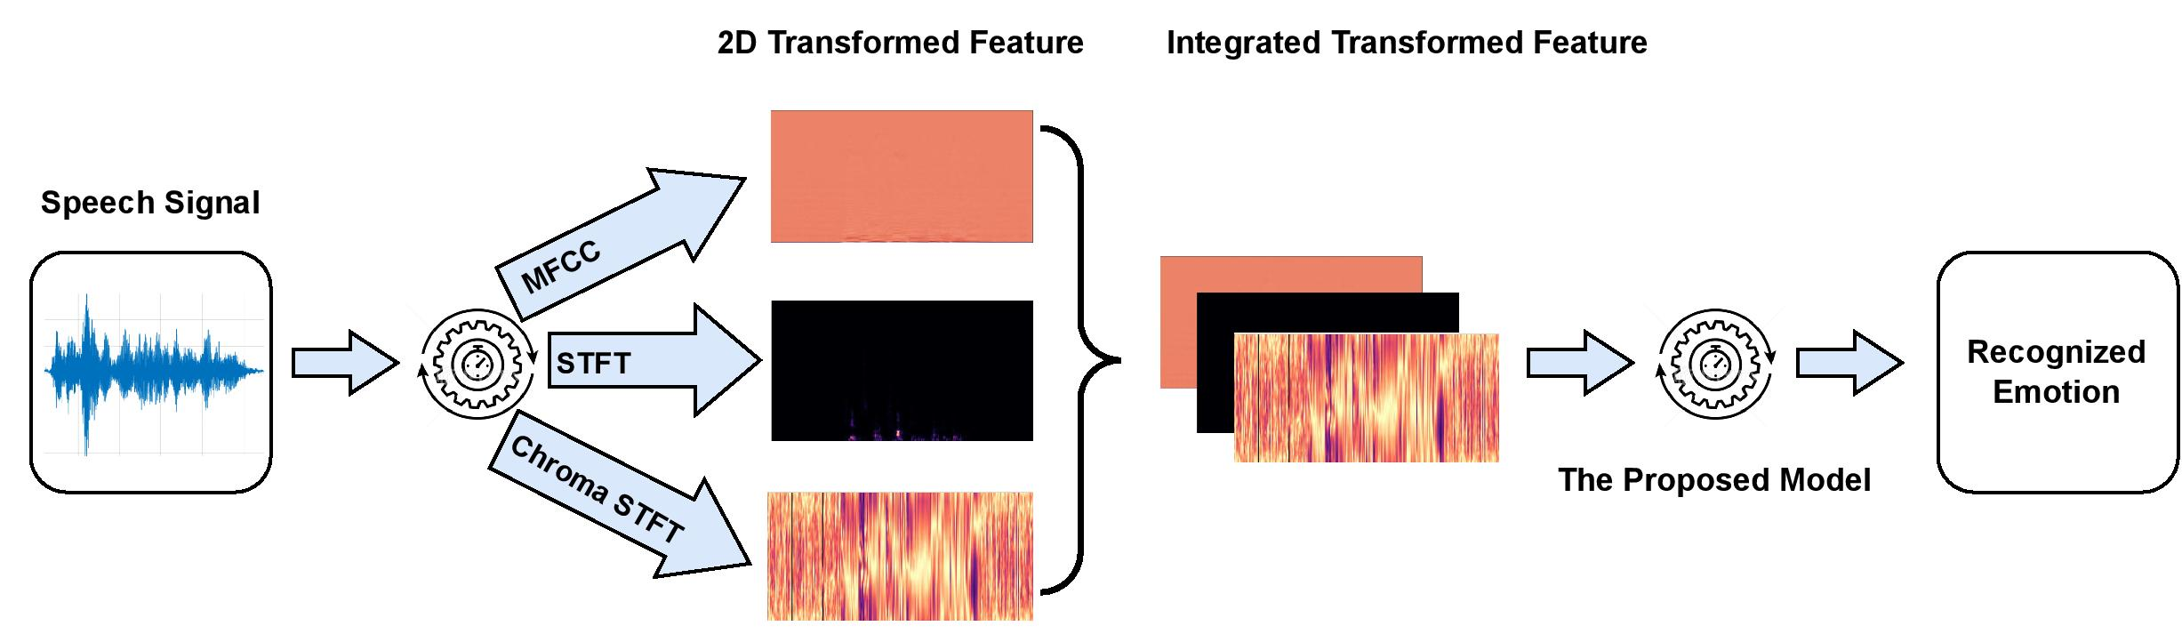
Methodology
Figure 2: General architecture of the proposed method.

Slide 15
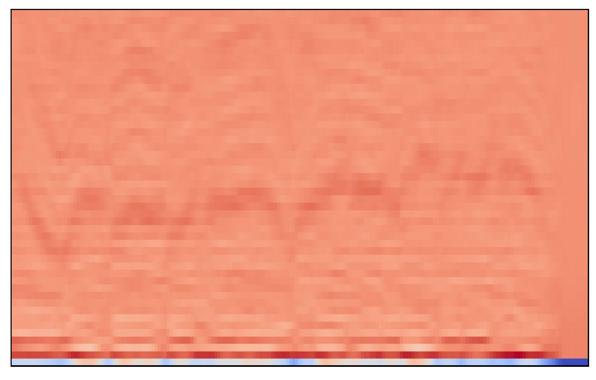
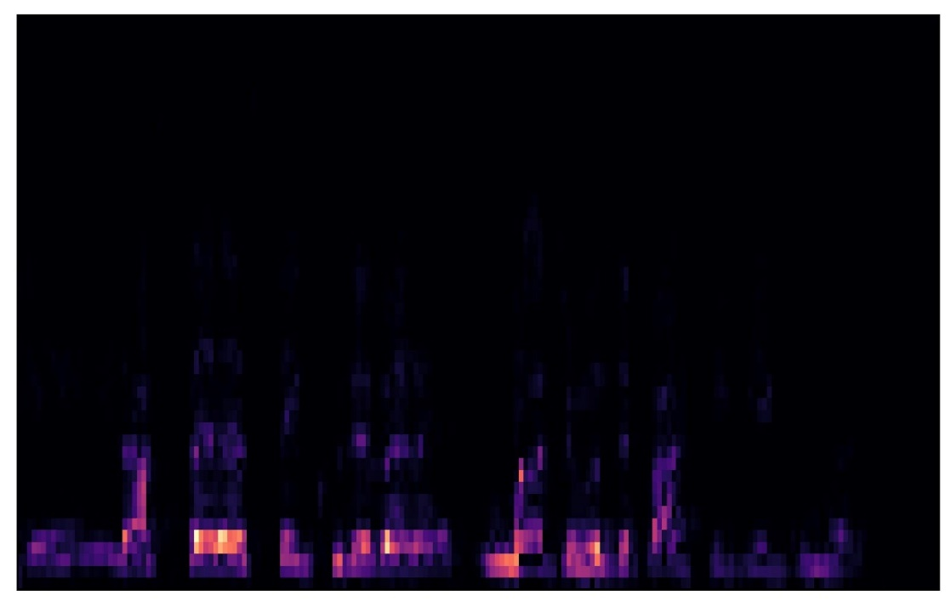
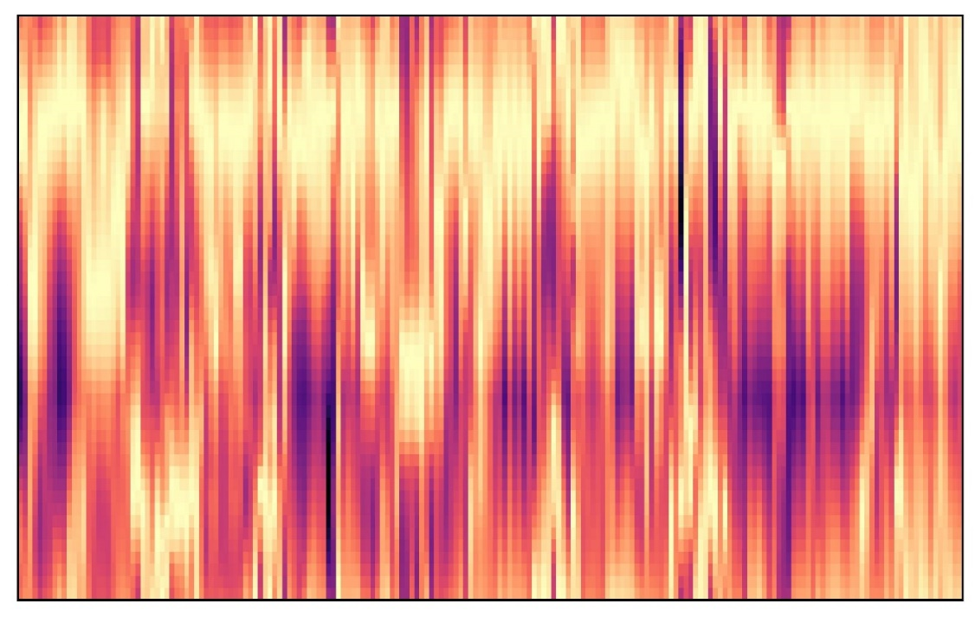
Speech Signal Transformation
(a) MFCC (b) STFT (c) Chroma STFT
Figure 3: Sample feature transformation of the proposed method.

Slide 16
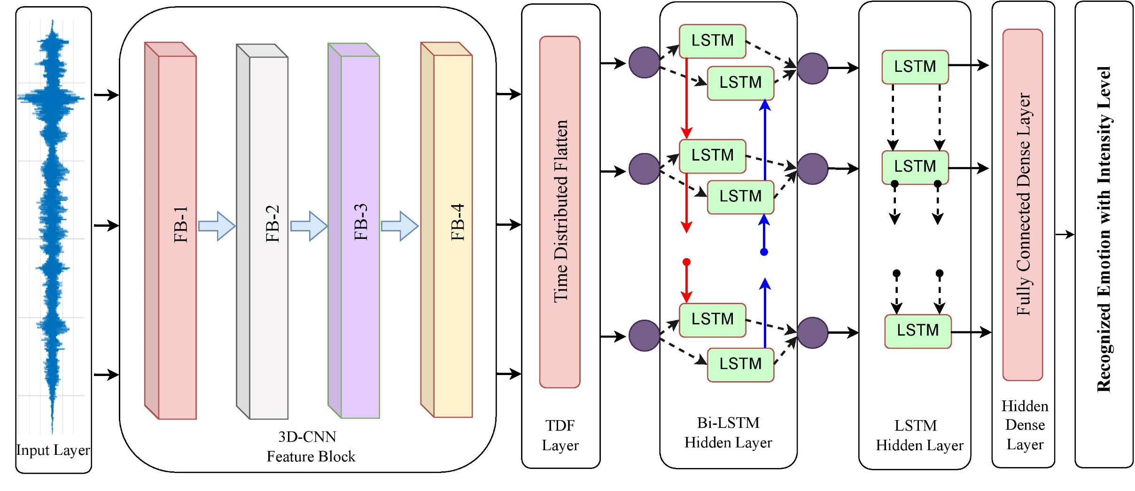
The Architecture of the Proposed Deep Learning Model
Figure 4: Basic building block structure of the proposed deep learning.

Slide 17
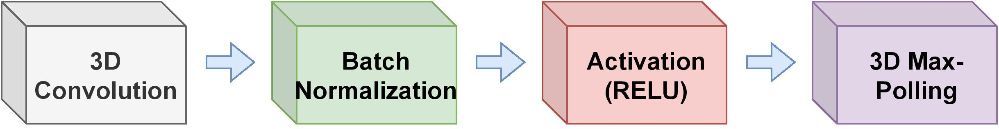
The Architecture of the Proposed Deep Learning Model
Figure 5: Structure of the convolutional feature block.

Slide 18
The Hyper-parameters of the Proposed Model Architecture
Feature Block | Layers | Input Shape | Output Shape | Filters | Kernel Size | Strides | Units
FB-1 | Conv3D | 128 × 513 × 3 | 128 × 513 × 3 @ 64 | 64 | 5 × 5 × 5 | 1 × 1 × 1 | -
 | MaxPolling3D | 128 × 513 × 3 @ 64 | 64 × 256 × 3 @ 64 | - | 2 × 2 × 1 | 2 × 2 × 1 | -
FB-2 | Conv3D | 64 × 256 × 3 @ 64 | 64 × 256 × 3 @ 64 | 64 | 5 × 5 × 5 | 1 × 1 × 1 | -
 | MaxPolling3D | 64 × 256 × 3 @ 64 | 16 × 64 × 3 @ 64 | - | 4 × 4 × 1 | 4 × 4 × 1 | -
FB-3 | Conv3D | 16 × 64 × 3 @ 64 | 16 × 64 × 3 @ 128 | 128 | 5 × 5 × 5 | 1 × 1 × 1 | -
 | MaxPolling3D | 16 × 64 × 3 @ 128 | 4 × 16 × 3 @ 128 | - | 4 × 4 × 1 | 4 × 4 × 1 | -
FB-4 | Conv3D | 4 × 16 × 3 @ 128 | 4 × 16 × 3 @ 128 | 128 | 5 × 5 × 5 | 1 × 1 × 1 | -
 | MaxPolling3D | 4 × 16 × 3 @ 128 | 1 × 4 × 3 @ 128 | - | 4 × 4 × 1 | 4 × 4 × 1 | -
- | TDF | 1 × 4 × 3 @ 128 | 1 × 1536 | - | - | - | -
- | Bi-LSTM | 1 × 1536 | 1 × 512 | - | - | - | 256
- | LSTM | 1 × 512 | 256 | - | - | - | 256
- | Dense | 256 | 9/5/2 | - | - | - | 9/5/2

Slide 19
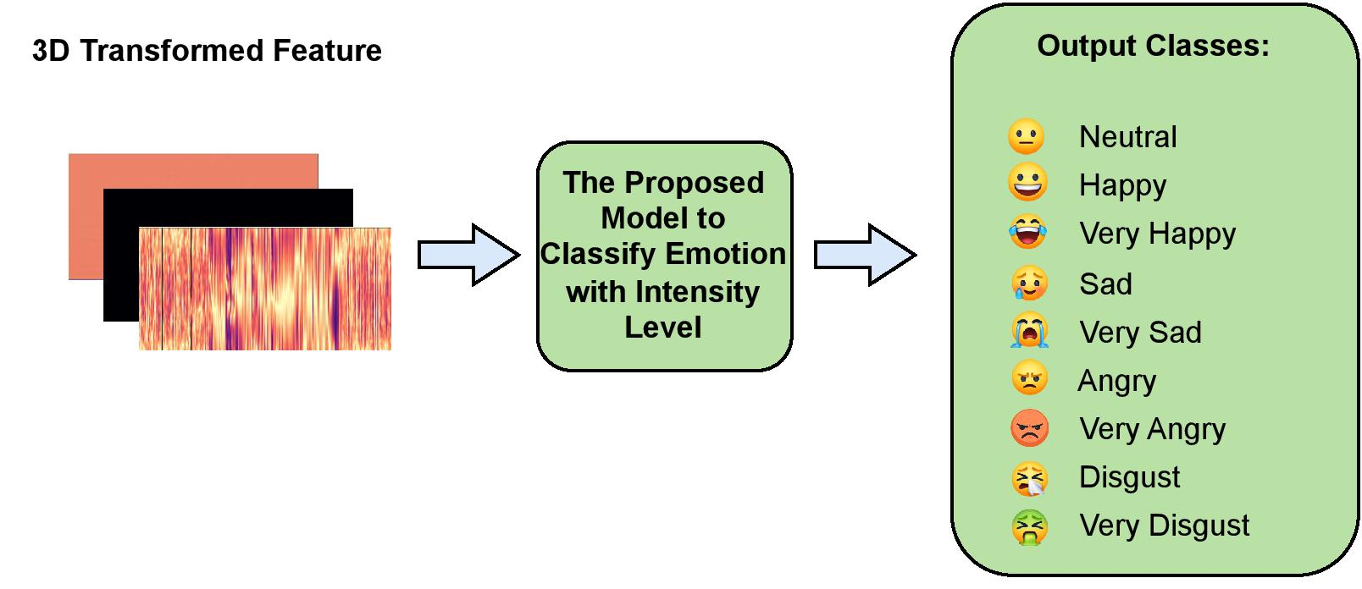
Single Classifier Model Framework
Figure 6: Classify emotion with intensity from 3D transformed speech signal.

Slide 20
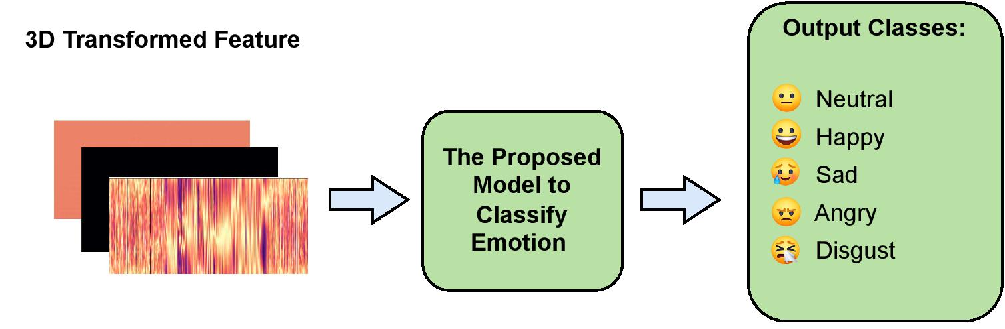
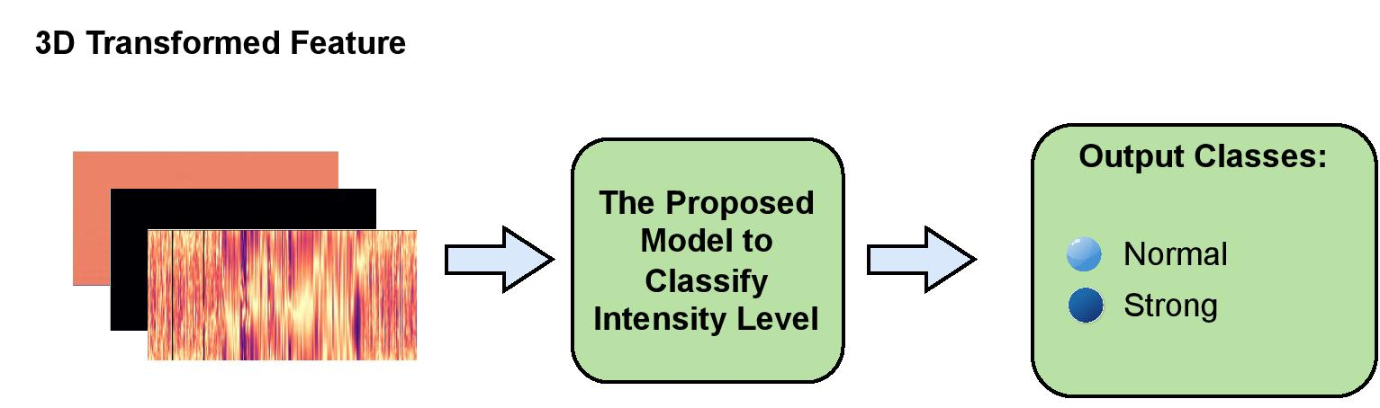
Cascaded Model Framework
Figure7 : Stage 1: Classify emotion from 3D transformed feature.
Figure 8: Stage 2: Measure intensity for emotion classified in Stage 1.

Slide 21
Experimental Results and Analysis
Adam as the optimizer
Learning rate is 10⁻⁴
Loss function is categorical crossentropy
Trained for 64 epochs
Batch size is 16

Slide 22
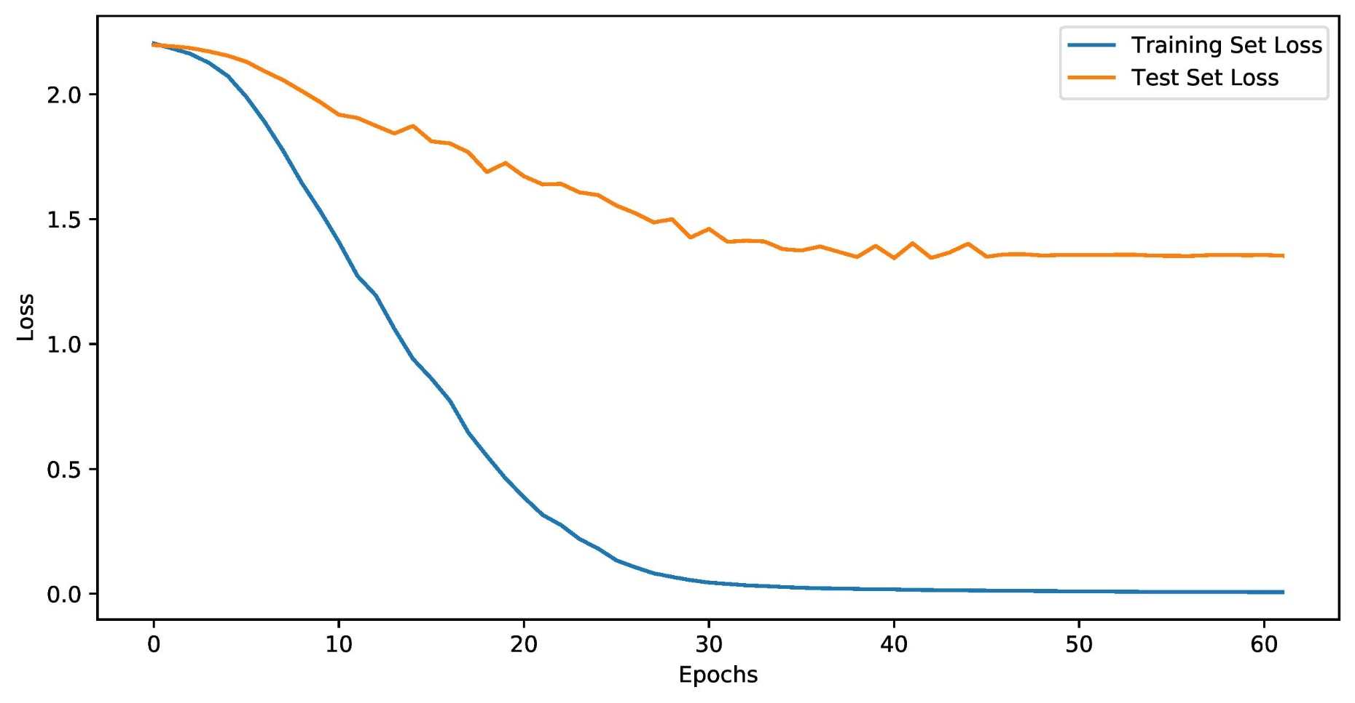
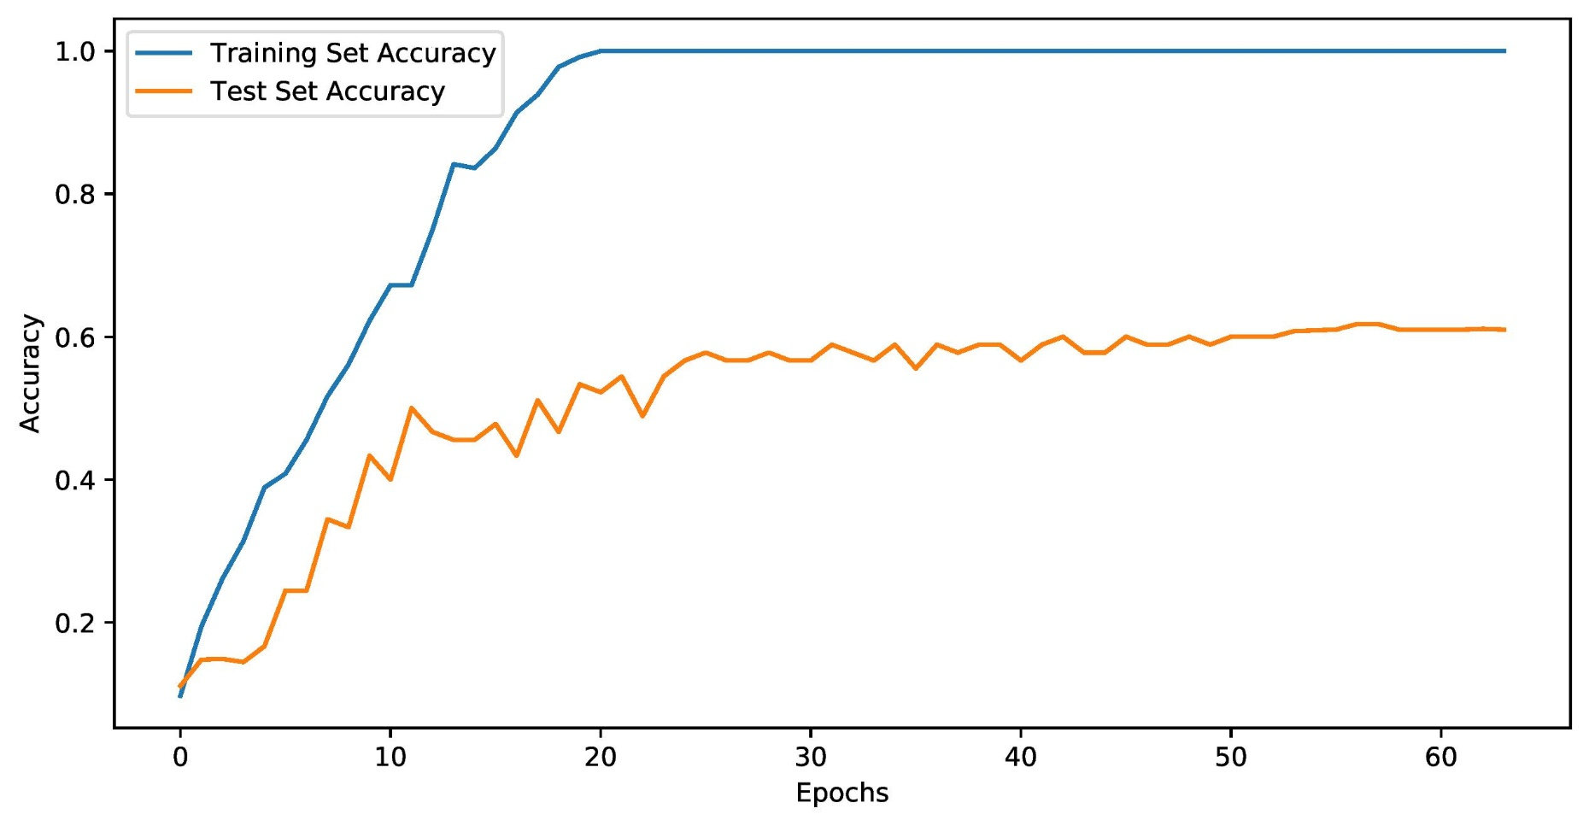
Loss Curve and Accuracy Curve for Single Classifier Model
Figure 9: Loss vs epochs curve.
Figure 10: Accuracy vs epochs curve.

Slide 23
Confusion Matrix for Single Classifier Model with Intensity Level
Emotion | Emotion Intensity | Neutral | Happy |  | Sad |  | Angry |  | Disgust |  | Category Miss | Intensity Miss | Total
 |  |  | Normal | Strong | Normal | Strong | Normal | Strong | Normal | Strong
Neutral | - | 11 | 3 | 0 | 2 | 0 | 1 | 1 | 1 | 1 | 9 | 0 | 20
Happy | Normal | 1 | 10 | 1 | 2 | 2 | 2 | 0 | 2 | 0 | 9 | 1 | 20
 | Strong | 1 | 5 | 12 | 0 | 0 | 0 | 0 | 2 | 0 | 3 | 5 | 20
Sad | Normal | 0 | 2 | 0 | 11 | 1 | 1 | 1 | 2 | 2 | 8 | 1 | 20
 | Strong | 0 | 2 | 0 | 1 | 17 | 0 | 0 | 0 | 0 | 2 | 1 | 20
Angry | Normal | 0 | 0 | 0 | 0 | 2 | 13 | 4 | 1 | 0 | 3 | 4 | 20
 | Strong | 0 | 0 | 0 | 1 | 0 | 5 | 14 | 0 | 0 | 1 | 5 | 20
Disgust | Normal | 1 | 1 | 0 | 0 | 1 | 5 | 1 | 10 | 1 | 9 | 1 | 20
 | Strong | 0 | 0 | 0 | 0 | 0 | 0 | 3 | 5 | 12 | 3 | 5 | 20
 | Total |  |  |  |  |  |  |  |  |  | 47 | 23 | 180
 | Accuracy |  |  |  |  |  |  |  |  |  | 61.11%

Slide 24
Confusion Matrix for Cascaded Model without Intensity Level
Emotion | Neutral | Happy | Sad | Angry | Disgust | Correct | Category Miss | Total
Neutral | 12 | 1 | 2 | 3 | 2 | 12 | 8 | 20
Happy | 5 | 28 | 1 | 2 | 4 | 28 | 12 | 40
Sad | 2 | 3 | 31 | 1 | 3 | 31 | 9 | 40
Angry | 0 | 0 | 0 | 35 | 5 | 35 | 5 | 40
Disgust | 1 | 0 | 3 | 7 | 29 | 29 | 11 | 40
 | Total |  |  |  |  | 135 | 45 | 180
 | Accuracy |  |  |  |  | 75.00 %

Slide 25
Confusion Matrix for Cascaded Model with Intensity Level
Emotion | Emotion Intensity | Neutral | Happy |  | Sad |  | Angry |  | Disgust |  | Category Miss | Intensity Miss | Total
 |  |  | Normal | Strong | Normal | Strong | Normal | Strong | Normal | Strong
Neutral | - | 12 | 1 | 0 | 2 | 0 | 2 | 1 | 2 | 0 | 8 | 0 | 20
Happy | Normal | 3 | 14 | 1 | 0 | 0 | 0 | 0 | 2 | 0 | 5 | 1 | 20
 | Strong | 2 | 0 | 13 | 0 | 1 | 2 | 0 | 0 | 2 | 7 | 0 | 20
Sad | Normal | 2 | 2 | 0 | 14 | 0 | 0 | 0 | 1 | 1 | 6 | 0 | 20
 | Strong | 0 | 0 | 1 | 1 | 16 | 1 | 0 | 0 | 1 | 3 | 1 | 20
Angry | Normal | 0 | 0 | 0 | 0 | 0 | 15 | 2 | 2 | 1 | 3 | 2 | 20
 | Strong | 0 | 0 | 0 | 0 | 0 | 0 | 18 | 0 | 2 | 2 | 0 | 20
Disgust | Normal | 1 | 0 | 0 | 2 | 0 | 3 | 1 | 11 | 2 | 7 | 2 | 20
 | Strong | 0 | 0 | 0 | 0 | 1 | 0 | 3 | 1 | 14 | 4 | 1 | 20
 | Total |  |  |  |  |  |  |  |  |  | 45 | 7 | 180
 | Accuracy |  |  |  |  |  |  |  |  |  | 71.11 %

Slide 26
Comparison Between the Single Classifier and Cascaded Model
DL Model | Single Classifier Model |  |  | Cascaded model
 | Category Miss | Intensity Miss | Accuracy (%) | Category Miss | Intensity Miss | Accuracy (%)
Male | 18 | 14 | 64.44 | 20 | 4 | 73.3
Female | 21 | 13 | 62.22 | 21 | 5 | 71.11
Both | 47 | 23 | 61.11 | 45 | 7 | 71.11

Slide 27
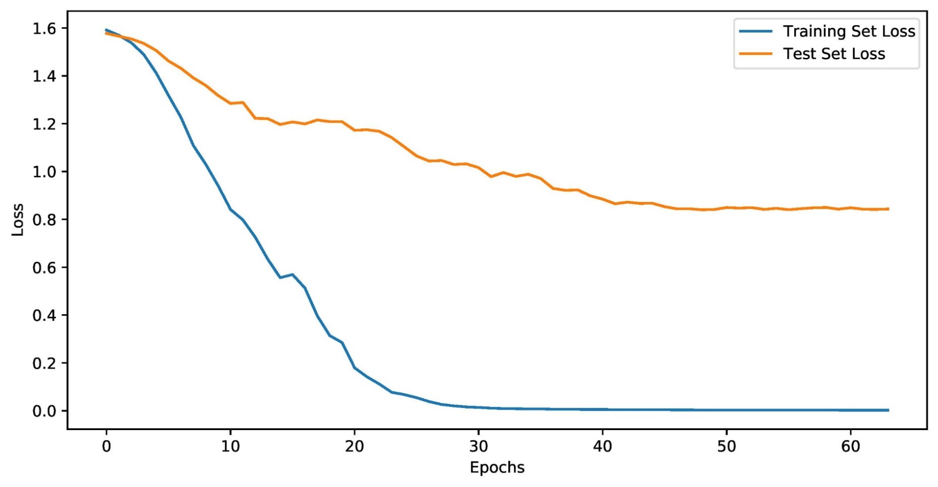
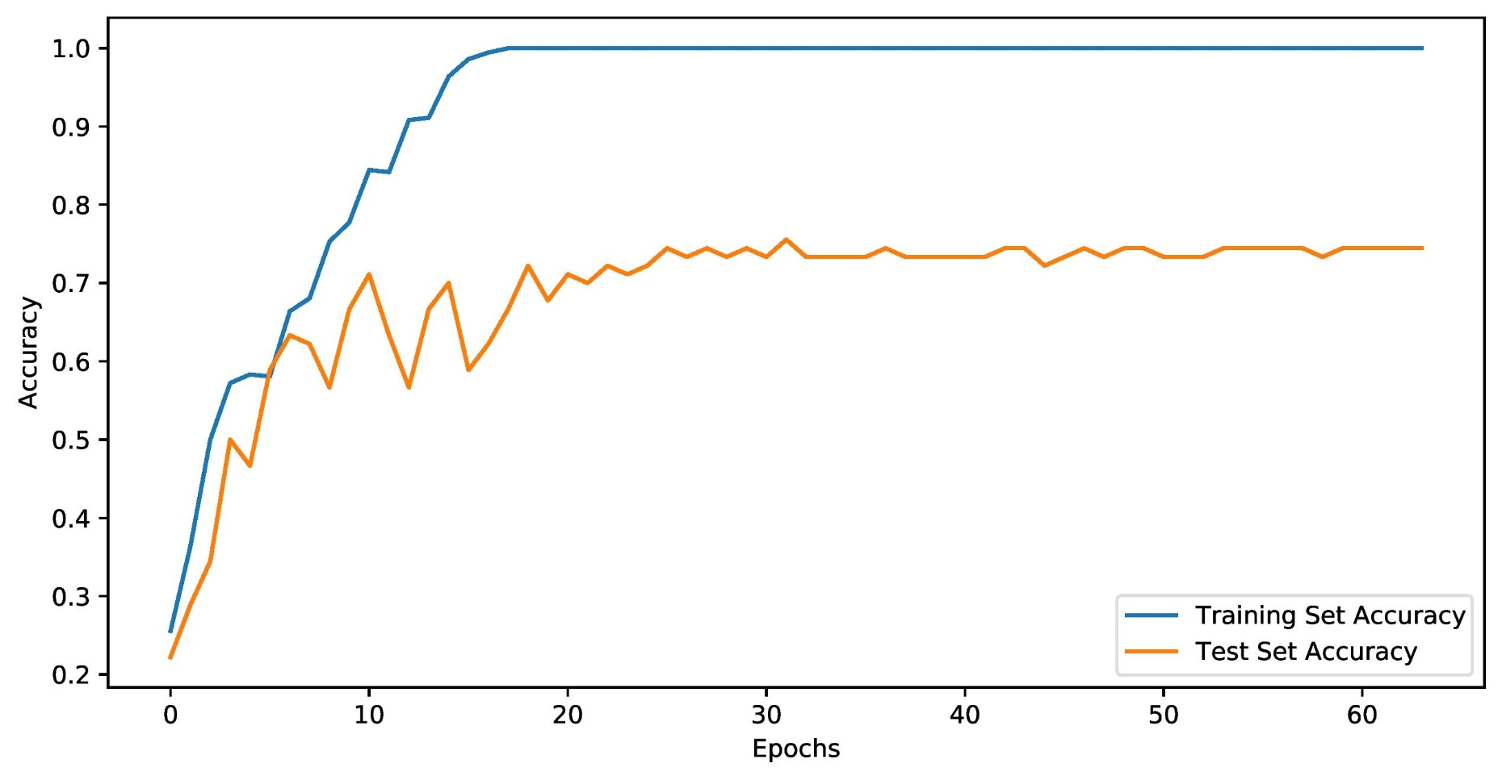
Loss Curve and Accuracy Curve for Cascaded Model
Figure 11: Loss vs epochs curve.
Figure 12: Accuracy vs epochs curve.

Slide 28
Comparison with Diﬀerent Signal Transformations for Cascaded Model
Combination | Signal Transformation | Sequences ×Frames × Dimension | Category Miss | Intensity Miss | Total Miss | Accuracy (%)
Individual | Log-Mel spectrums | 128×513×1 | 40 | 23 | 63 | 65.00
 | MFCC | 128×513×1 | 48 | 24 | 72 | 60.00
 | STFT | 128×513×1 | 62 | 24 | 86 | 52.22
 | CSTFT | 128×513×1 | 66 | 32 | 98 | 45.56
Double | MFCC+STFT | 128×513×2 | 53 | 17 | 70 | 61.11
 | STFT+CSTFT | 128×513×2 | 61 | 27 | 88 | 51.11
 | MFCC+CSTFT | 128×513×2 | 50 | 25 | 75 | 58.33
Multiple | Log-Mel spectrums + MFCC + STFT + CSTFT | 128×513×4 | 45 | 25 | 70 | 61.11
 | MFCC+STFT+CSTFT | 128×513×3 | 45 | 7 | 52 | 71.11

Slide 29
Model Comparison for BESCK Dataset
Model Name | Accuracy (%)
7CNN + FC | 62.22
7CNN + TDF + LSTM | 67.84
7CNN + TDF + BiLSTM | 68.67
4CNN + FC | 63.54
4CNN + LSTM | 65.57
4CNN + TDF + LSTM | 68.89
4CNN + BiLSTM | 65.95
4CNN + TDF + BiLSTM | 69.46
The Proposed Model (4CNN + TDF + BiLSTM + LSTM) | 71.11

Slide 30
Conclusions
• This paper presented the development of a Bangla emotional speech corpus KUET (BESCK).
• Created with 900 random speeches from different actors, making the dataset realistic.
• Speech signal has been transformed into a 3D representation by integrating three separate 2D transformations.
• Developed a hybrid deep learning framework utilizing 3D CNN, Bi-LSTM, and LSTM enhance recognition performance.
• Achieved accuracy for the BESCK dataset is 71.11 %.

Slide 31
References
[1] Sadia Sultana, M. Shahidur Rahman, M. Reza Selim, and M. Zafar Iqbal. SUST bangla emotional speech corpus (SUBESCO): An audio-only emotional speech corpus for bangla. PLOS ONE, 16(4):e0250173, April 2021.
[2] Rakesh Kumar Das, Nahidul Islam, Md Rayhan Ahmed, Salekul Islam, Swakkhar Shatabda, and AKM Muzahidul Islam. Banglaser: A speech emotion recognition dataset for the bangla language. Data in Brief, 42:108091, 2022.
[3] Md Riadul Islam, MAH Akhand, Md Abdus Samad Kamal, and Kou Yamada. Recognition of emotion with intensity from speech signal using 3d transformed feature and deep learning. Electronics, 11(15):2362, 2022.
[4] Sadia Sultana, M Zafar Iqbal, M Reza Selim, Md Mijanur Rashid, and M Shahidur Rahman. Bangla speech emotion recognition and cross-lingual study using deep cnn and blstm networks. IEEE Access, 10:564–578, 2021.

Slide 32
Thank You

